Slide 1

World Bank Indicators - Predicting The Gini Index
Team 5 - CSSE-415, Spring 2024-2025
Abdullah Islam, Agnay Srivastava, Parth Sundaram, Steven Johnson
Notes:
Gm everybooyd, we are Team 5, presenting our analysis on predicting the ingi index using the WB’s Development indicators

Slide 2
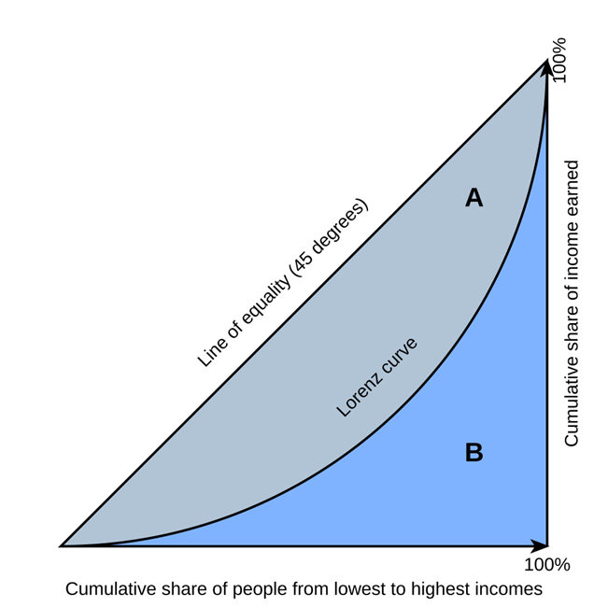

What is the Gini Index?
$$Gini=\frac{A}{A+B}$$
It is a measure of income inequality:
0 = perfect equality
100 = perfect inequality
Ratio of area between the Lorenz Curve & equality line
Highest & Lowest
South Africa at 63
Slovakia at 23.2
Notes:
Used for Any Global Policy, such as providing aid, that involves income distribution
As the curve squishes against the sides of the triangle, the gini index increases
Meaning that a small percentage has a lot of the wealth
SA_> 2014
Slovakia -> 2023
Collection: Official national surveys & administrative sources
Applications
Compare inequality across countries/years
Monitor policy impact (taxation, welfare)
Identify trends (rising or falling inequality)

Slide 3
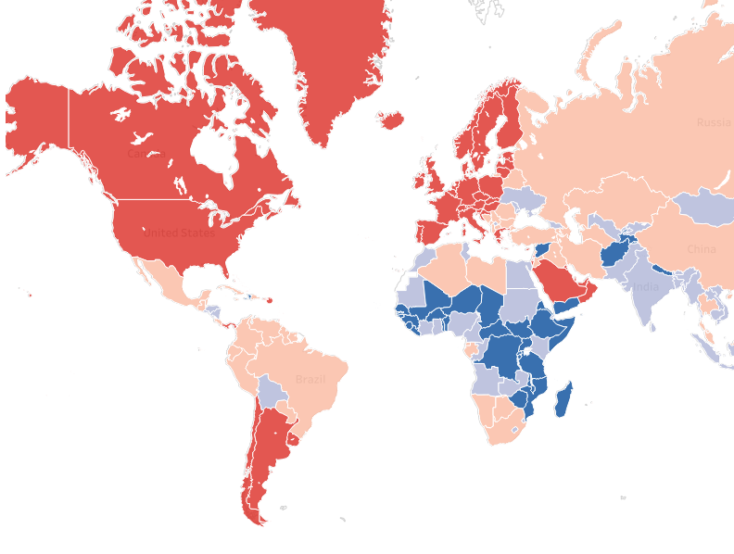
Our Kaggle Dataset: A Summary
Annual WB data since 1960
274 economies
50+ socio-economic, environmental, and institutional metrics
Size: ~ 17,000 x 50.
The main operations we perform are
Cleaning
Imputation
Time-Series Analysis
Notes:
Problem : Inequality:
Care -> Applications
Challenging -> Unlike a lot of other “dummy” datasets available on Kaggle, ours includes messy real world data, with high levels of missingess.
Interesting approach is: Evaluated many cleaning strategies, many data imputation strategies, many time series analysis, and run all of this against a variety of models.
Needs trustthworty, income surveys which hare expensive and unabaivlable in low income unstable regeions, which is where they are most required.

Slide 4

4 Core Data Cleaning Steps
We filter years 2002 – 2020
Drop 15 Sparse, Irrelevant & Discontinued Features
Drop countries ≥ 90 % empty values
Finally, drop countries with no Gini-Index
Before: 274 Economies $→$ After : 163
Notes:
No categorical values

Slide 5
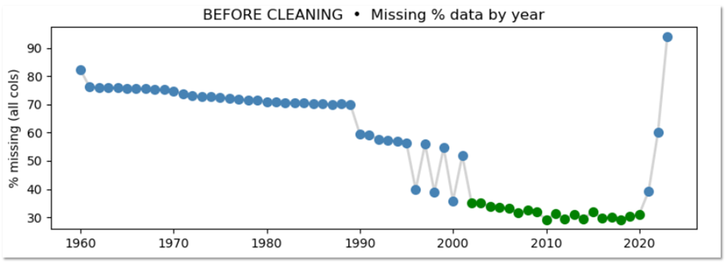
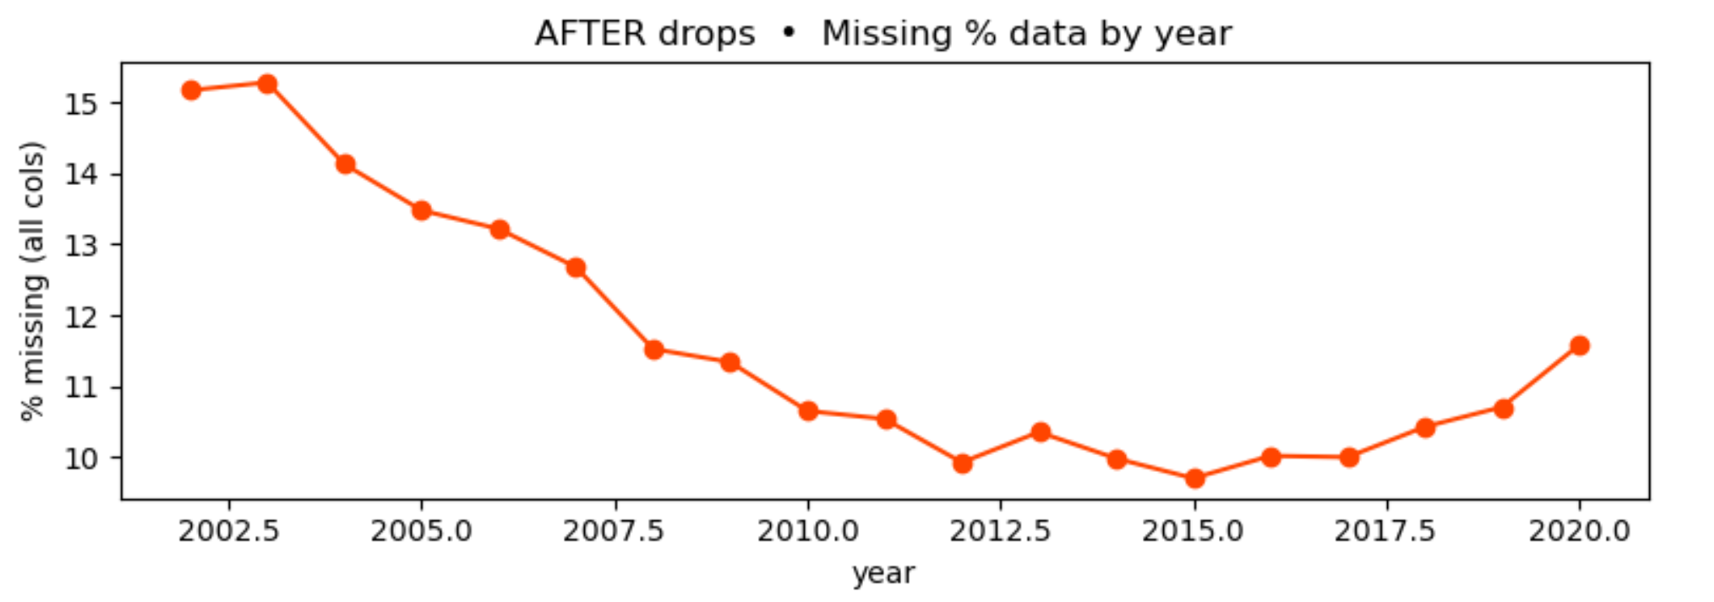
Before vs After Cleaning [1/3]:
Keep 2002-2020

Slide 6
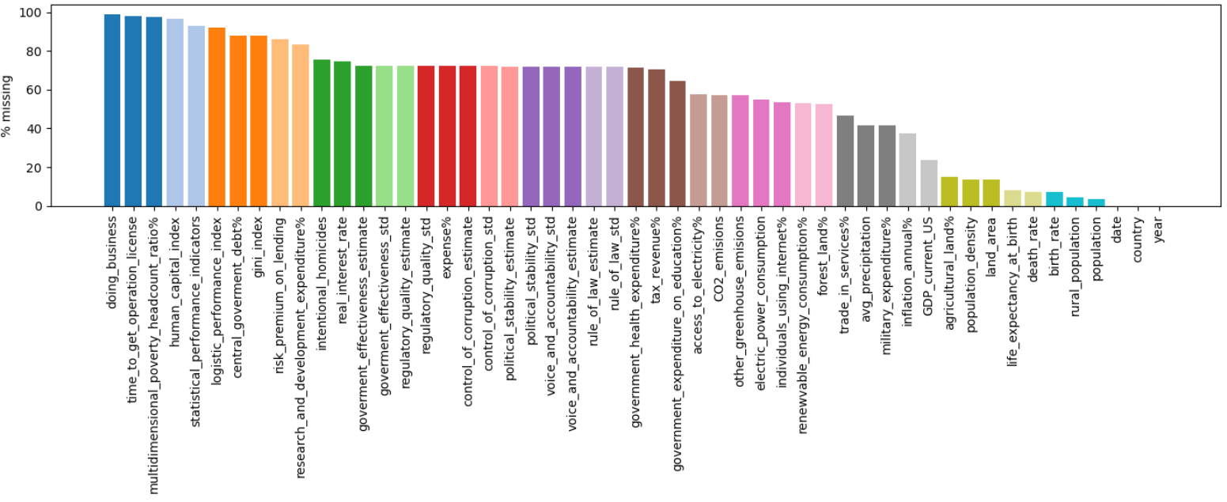
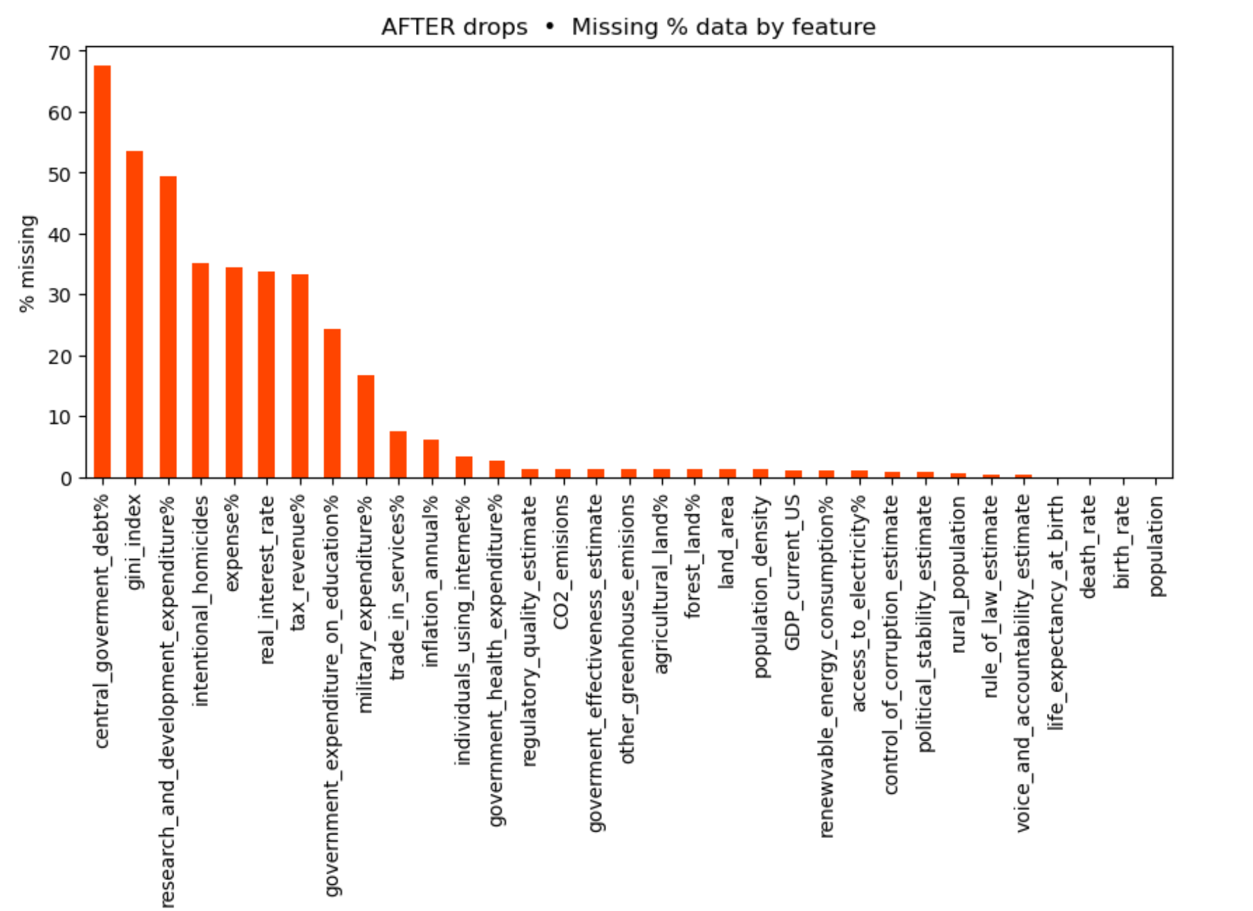

Before vs After Cleaning [2/3]:
Notes:
See that aside from an outlier, Values are in the 20-35% range
Gini Index Not computed Every year, and its not computed at regular intervals either

Slide 7
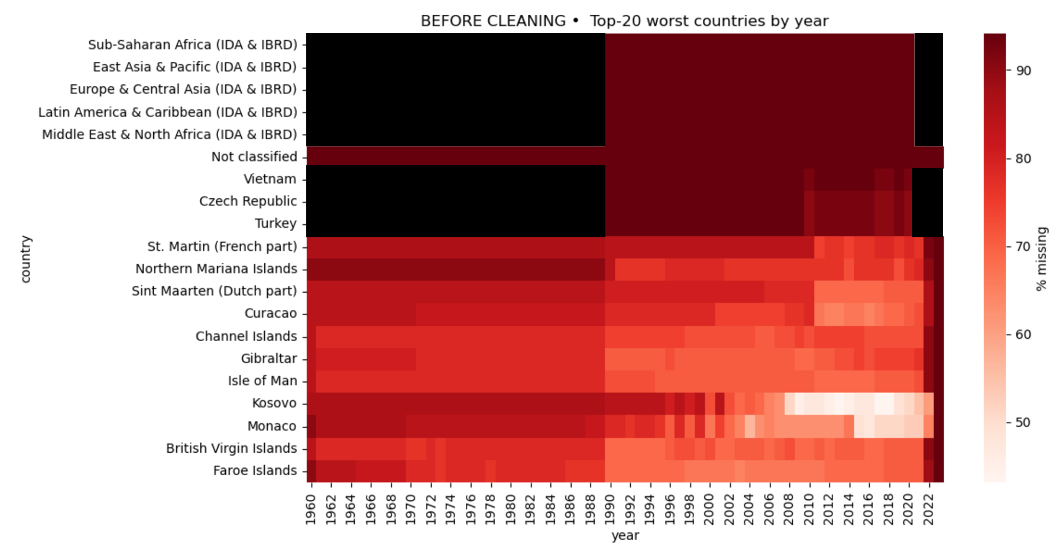
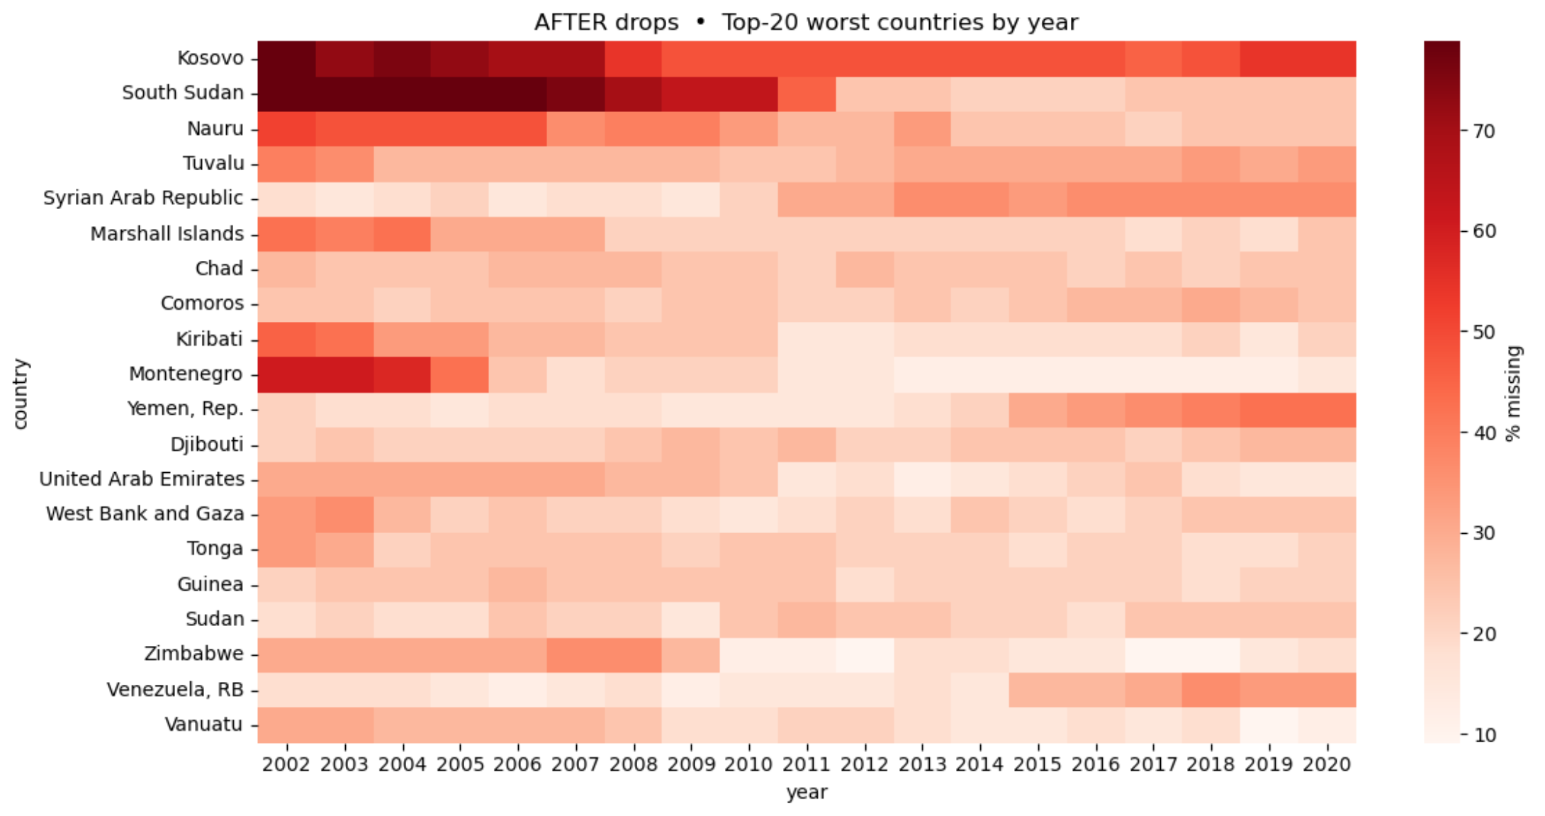
Before vs After Cleaning [3/3]: Top 20 Countries With the Most Missing Data

Slide 8
Mean Imputation Results
• Dataset Size: 3,097 rows × 36 columns
KNN:
K optimization
MICE:
Complex
Miss-Forest:
Slow, Poor Interpretability
Per-Country Mean:
Simple & Interpretable
Doesn’t use other features
Two-Stage Strategy
Country-Mean Fill
Global Fallback
Notes:
For each missing cell, fill with that country’s mean (2002–2020) If country mean unavailable, fill with global mean
(We left date/year/Gini untouched to avoid leakage)
Remind them that this data set has dropped a lot of the years and bad features and bad countries. As well as any country without a gini during that time period.

Slide 9
Time Series Feature Engineering
Set 1: Year t
All features from the year before the Gini value
Total of 32 features
Set 2: Year-t + Rolling Stats
All features plus 5-year rolling mean & rolling STD
Total of 32*3 = 96 features
Set 3: Five-Year Lags
Which keeps all the raw indicators for t – 1, t – 2, t – 3, t – 4.
Total of 32*5 = 160 features

Slide 10
Recap – The Big Picture So Far [1/2]
Cleaning: We removed features and countries with high degrees of missingness.
Imputation: Filled in what was still missing
Time-Series: Used data from past years for new feature columns and generated 3 datasets for each model to use.
Our philosophy was to pick interpretability over complex procedures that promised accuracy.
NO Polynomial Features, PCA

Slide 11
Recap – Dataset Numbers [2/2]
Feature Set |  | X_train (rows × cols) | X_test (rows × cols)
1: | 1 Year lag | 813 × 32 | 216 × 32
2: | Year 1 + Rolling stats | 813 × 96 | 216 × 96
3: | 5 Year lags | 813 × 160 | 216 × 160
Using each of the 3 data sets, we create 3 train/test sets.
80/20 Split by country.
Y Train / Test stay the same, as only features change.

Slide 12
Model | Data Set 1 (year 1) | Data Set 2 (year 1 + rolling mean + std) | Data Set 3 (year 1-5) | Avg R² %
 | R² % | R² % | R² %
Simple Bias | -2.2 | -2.2 | -2.2 | -2.2
Linear Regression | 39.9 | 53.4 | 43.0 | 45.1
Linear + Forward Feature Selection | 40.0 | 53.1 | 44.2 | 45.8
Ridge Regression | 34.7 | 42.5 | 38.4 | 38.5
Lasso Regression | 35.6 | 51.1 | 33.3 | 40.0
Random Forest | 54.3 | 49.3 | 49.7 | 51.1
Gradient Boosted Trees | 50.6 | 53.6 | 50.4 | 51.5
K-Nearest Neighbors | 45.4 | 43.9 | 45.4 | 44.6
Avg R² % | 42.9 | 49.6 | 43.5
Notes:
Mention use of gridsearch and groupkfold validation

Slide 13
Interpretation [1/3]:
Best Dataset Type:
Model | Set 1 | Set 2 | Set 3 | Avg R²
 | R² % | R² % | R² %
SBR | -2.2 | -2.2 | -2.2 | -2.2
LR | 39.9 | 53.4 | 43.0 | 45.1
LRFS | 40.0 | 53.1 | 44.2 | 45.8
Ridge | 34.7 | 42.5 | 38.4 | 38.5
Lasso | 35.6 | 51.1 | 33.3 | 40.0
RF | 54.3 | 49.3 | 49.7 | 51.1
GBT | 50.6 | 53.6 | 50.4 | 51.5
KNN | 45.4 | 43.9 | 45.4 | 44.6
Avg R² | 42.9 | 49.6 | 43.5
Set 1 – Year-t only (R² ≈ 43 %)
Inadequate temporal analysis -> high bias
Set 3 – Five-Year Lags (R² ≈ 44 %)
Collinearity and imputation noise -> high variance
Set 2 – Year-t + Rolling Stats (R² ≈ 50 %)
Captures temporal trends, avoiding noise
Notes:
Why Dataset 2 Performed Best
1. 📈 Captures Temporal Dynamics Without Overfitting
The 5-year rolling mean introduces trend information, letting the model understand how stable or growing features (e.g. income, education, health spending) are.
Compared to Dataset 3, which directly includes all past 5 years' values (160 features), Dataset 2 compresses history more efficiently and robustly, reducing noise.
2. ⚖️ Better Bias–Variance Tradeoff
Dataset 1 is too simple: it captures only one year’s snapshot, making it high bias, missing the context of previous years.
Dataset 3 is too complex: it has high variance, leading to overfitting, especially since your total training size is 813 samples.
Dataset 2 finds the sweet spot: medium complexity, capturing trends while avoiding the curse of dimensionality.
5. 🌍 Policy-Relevant Variables Have Lagged Effects
Social and economic policies affect Gini Index with a lag — e.g., a new education program shows results 2–3 years later.
Rolling stats implicitly reflect those lagged influences better than a single year’s value.
Set 1 – Year-t only (R² ≈ 43 %) • Captures only a snapshot of macro conditions • Misses trend or volatility signals → limited context
Set 2 – Year-t + Rolling Stats (R² ≈ 50 %) • Adds 5-year mean & std → smooths noise and encodes momentum • Strikes best balance of history vs. complexity → highest predictive power
Set 3 – Five-Year Lags (R² ≈ 44 %) • Incorporates raw values t…t–4 → full history • Very high dimensionality → noise and overfitting dilute gains

Slide 14
Interpretation [2/3]: Best Model Types
Gradient Boosted Trees
Best R² on Set 2 (best performing dataset)
Performance stayed at a 50-54% R²range across datasets
Random Forests
Best Single R² -> on Set 1
Performance stayed in the high 40% to low 50% range across datasets
Why did they outperform the other models?
Non-linear relationships
Built-in feature selection
Robust to noise
Model | Set 1 | Set 2 | Set 3 | Avg R²
 | R² % | R² % | R² %
RF | 54.3 | 49.3 | 49.7 | 51.1
GBT | 50.6 | 53.6 | 50.4 | 51.5
Gradient Boosted Trees -> best model even though Random Forests had the highest R² of any model on Set 1!
Notes:
Non linear relationshps captured better by trees
Feature selection – knn weights all features equally (problem) and you would need to regularize linear models
Robust to noise because of bagging (selection of data records with replacement) and the usage of only a few features – and boosting (which iteratively corrects residuals)

Slide 15
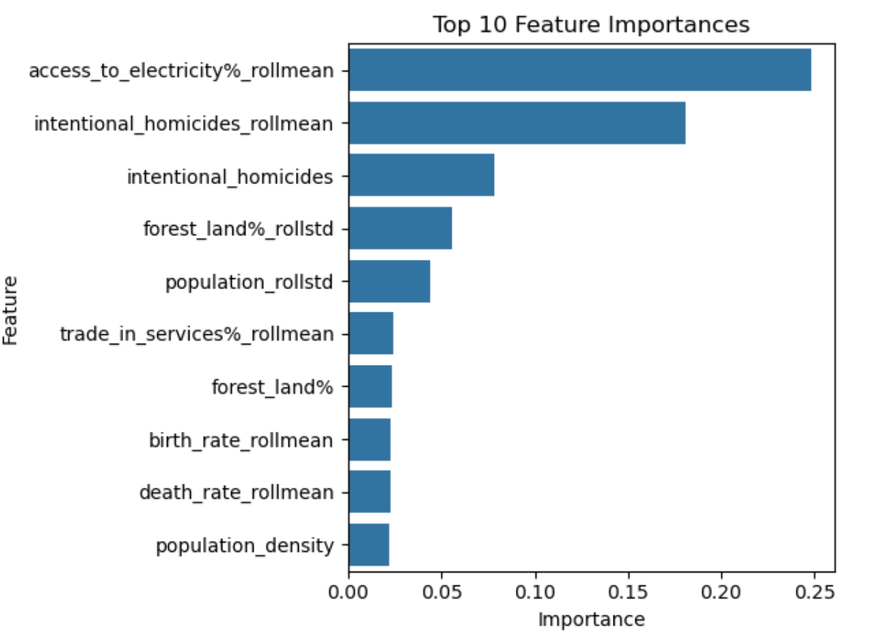
Interpretation [3/3]: Best Features from our Top Models
Intentional Homicides (per 100,000 people)
Interpretation: Higher income inequality -> instability -> violence
Forest Land (% of land area)
Interpretation: Less urbanization -> more dispersed, rural populations -> less ability to regulate those with power -> higher income inequality
Access to Electricity (% of population)
Interpretation: electricity -> urbanization and machinery -> wider array of jobs-> lower income inequality
Death Rate (per 1,000 people)
Unexpected Insight: Negative correlation
Best Model – GBT on Set 2
Notes:
These top 4 features were in among the most importance features for 4 out of 5 of the top performing models.
Intentional Homicide had a positive correlation
Forest Land had a positive correlation
Access to Electricity had a negative correlation
Death Rate had a negative correlation
Across our best-performing models (Test R2 >= 50%)
Linear Regressor, X2, Rolling
Linear with Feature Selection, X2
Lasso on X2 Rolling
Random Forest on X1
GBT on X2
Honorable Mentions (2 models): R&D (negative correlation), population (+), greenhouse (differs between itself and rollmean in polarity), birth rate (only in trees), trade in services (only in trees)
Intentional Homicides
Strongly linked to social instability andinequality. Countries with higher Gini oftenshow elevated violence due to marginalizationand weak institutions.
Access to Electricity (% of population)
Highlights infrastructure inequality. Low accesssuggests limited opportunities, especially inrural or underserved areas.

Slide 16

Literature Review: Project Takeaways
From Li et al. ${\text{(2022)}}^{1}$
They developed a two-stage ensemble (picking the best of many models) to predict state fragility using 100+ World Bank Development Indicators (WDI).
We loosely adopt their concept, comparing several models.
We also found that RFs and GBTs work the best.
From Koç & Akın ${\text{(2021)}}^{2}$
They compared linear vs. tree-based methods for next-year Gini forecasting on OECD nations, using median imputation.
Building on their analysis, we add more features, test more countries and imputers, and adopt their focus on next-year Gini forecasting.
Similarly, we found that RF outperformed linear baselines.
X. Li, A. Vidmer, H. Liao, and K. Lu, "Data-Driven State Fragility Index Measurement Through Classification Methods," Frontiers in Physics, vol. 10, Art. no. 830774, Feb. 2022, https://doi.org/10.3389/fphy.2022.830774
T. Koç and P. Akın, “Comparison of Machine Learning Methods in Prediction of the Gini Coefficient for OECD Countries,” Data Science and Applications, vol. 4, no. 1, pp. 16–20, 2021. [Online]. Available: https://dergipark.org.tr/en/pub/datasci/issue/90860/1662110.
Notes:
Li et al. (2022)
Developed a two-stage ensemble to predict state fragility using 100+ World Bank Development Indicators (2000–2020).
Key steps: heavy feature pruning, per-group model training, majority-vote aggregation.
Our takeaway: we compare Random Forest and Gradient Boosting on WDI and adopt their ensemble‐style validation.
Hatimi et al. (2024)
Forecasted national education outcomes by dropping >50%-missing indicators, mean-imputing the rest, then tuning via 5-fold CV.
Demonstrated that simple imputation + regularized linear models can achieve R²≈0.48.
Our takeaway: we apply a stricter missingness threshold, replace plain CV with GroupKFold, and explore richer imputation.
Muñetón-Santa & Manrique-Ruiz (2023)
Combined WDI with spatial data (e.g. distance to capital) to predict multidimensional poverty, using Random Forests.
Emphasized feature importance to uncover non-linear drivers.
Our takeaway: we mirror their importance analysis to validate which WDI indicators truly drive Gini shifts.
Koç & Akın (2021)
Compared linear vs. tree-based methods for next-year Gini forecasting in OECD, using median imputation.
Found Random Forest (R²≈0.71) outperformed linear baselines.
Our takeaway: we extend their baseline to a global dataset, test both mean and advanced imputers, and shift the target by one year.
We adopted methodology similar to the second paper but they only used OECD countries and 5 features – we improved on this by expanding our predictions to the entire globe and we use 32 features

Slide 17
Obstacles We Faced Throughout
Data Leakage in Cross-Validation:
Standard K-Fold mixes country–year rows.
Switched to GroupKFold by country - preventing inflated R².
Time-Series Feature Engineering
Few easy, accurate and interpretable methods.
Compared 2 strategies against our n-1 year baseline.
Excessive Missingness
Several empty series, risking biased imputations.
Dropped features and countries with large gaps.
Applied interpretable
Notes:
In the future, integrate MICE or missForest.

Slide 18
Model Demo! Pick a Country, Any Country.

Slide 19
Strengths & Weaknesses of Best Model GBT + Data Set 2
Strengths | Weaknesses
Top accuracy of all models | Less interpretable – feature importance shows weight, not direction.
Captures non-linear + interaction effects automatically. | 2nd-ranked variable intentional homicides (35 % gaps)
Relies on widely reported metrics (electricity access, forest %, pop density, etc.) → no new surveys needed. | Key policy levers (tax, education spend) absent from top-10 → model may lean on proxies.
Trained with grouped CV → proven to generalise to unseen countries. | Only small gain over simpler linear + rolling (≈ 3 pp R²) for higher complexity.

Slide 20
Conclusion & Next Steps
Overall found that trees shine on lagged data.
Surprisingly, engineered simplicity is a close second (linear regressors)
Core Drivers of Inequality: Homicide Rates, Forest Land, Death Rates
Next Steps:
Implement Advanced Imputation.
Engineer Domain Driven Ratios (like GDP / pop)
Explore Dimensionality Reduction to reduce noise.
Check Model Fairness across income tiers and countries
Explore Bayesian Modelling

Slide 21
Thank You!

Slide 22
Model | Data Set 1 (year 1) |  | Data Set 2 (year 1 + rolling mean + std) |  | Data Set 3 (year 1-5) |  | Avg R² %
 | R² % | Hyper parameters | R² % | Hyper parameters | R² % | Hyper parameters
Simple | -2.2 |  | -2.2 |  | -2.2 |  | -2.2
Linear Regression | 39.9 | N/A | 53.4 | N/A | 43.0 | N/A | 45.1
Linear + Feature Selection | 40.0 | N/A | 53.1 | N/A | 44.2 | N/A | 45.8
Ridge Regression | 34.7 | α = 100 | 42.5 | α = 1000 | 38.4 | α = 1000 | 38.5
Lasso Regression | 35.6 | α = 0.01 | 51.1 | α = 0.1 | 33.3 | α = 1 | 40.0
Random Forest | 54.3 | n_estimators = 50, max_depth = 14 | 49.3 | n_estimators =120 max_depth = 15 | 49.7 | n_estimators =260 max_depth = 14 | 51.1
Gradient Boosted Trees | 50.6 | n_estimators = 20 lr = 0.16 max_depth = 3 | 53.6 | n_estimators = 50 lr = 0.06 max_depth = 3 | 50.4 | n_estimators = 90 lr = 0.16 max_depth = 3 | 51.5
K-Nearest Neighbors | 45.4 | k = 42 P = 1 ‘distance’ | 43.9 | k = 42 P = 1 ‘distance’ | 45.4 | k = 39 P = 1 ‘distance’ | 44.6
Avg R² % | 42.9 |  | 49.6 |  | 43.5
Notes:
Linear Regressors
Shine on smoothed (rolling) inputs—capture main trend with straight-line fits
Break down on raw or purely lagged data—can’t bend around non-linear effects
Tree Forests
Inherently model non-linearities and feature interactions
Robust to noise and outliers; shallow GBT on smooth data even mimics linear behavior
K-Nearest Neighbors
Struggles in high-dimensional space—neighbors all “far” away
No learned weighting—plain averaging can’t extract systematic signals

